Slide 1
Cell PHONE DETECTOR
Shivraj Kumbhar (26)
Tejas Mohite (21)
Shivraj Ghorpade (22)

Slide 2
Introduction
This project is a simple cell phone detector project. This handy cell phone detector, pocket size mobile transmission sniffer can sense the presence of an active cell phone in a radius of 1m-1.5m.
As the cell phone sends or receives a message or call, it sends off asignal. This signal is detected by our circuit and will cause the LED toblink and buzzer to sound.
This is the basic principle of the project.This simple circuit can detect any cellphone activities like sending orreceiving calls or SMS, or any type of data transmission.

Slide 3
History of Cell Phone Detector
In 2004 Möhring created a tracker for mobile phones that detects color-coded 3D marker shapes. The system's accurancy was very limited, since it did not take camera calibration or subpixel accuracy into account. In 2005 Henrysson created a Symbian port of ARToolKit, partially based on the ARToolKitPlus source code, which was used for the AR Tennis game, the first 2-player AR game on mobile phones. Around the same time Rohs created the VisualCodes system for Symbian smartphones. Similar to Möhring's approach, VisualCodes provides only simple tracking of 2D position on the screen, 1D rotation and a very coarse distance measure.

Slide 4
Definition of Cell Phone Detector
This handy mobile bug or cell phone detector, pocket-size mobile transmission detector or sniffer can sense the presence of an activated mobile cellphone from a distance of one and-a-half metres. So it can be used to prevent use of mobile phones in examination halls, confidential rooms, etc. It is also useful for detecting the use of mobile phone for spying and unauthorised video transmission.
The circuit can detect both the incoming and outgoing calls, SMS and video transmission even if the mobile phone is kept in the silent mode. The moment the bug detects RF transmission signal from an activated mobile phone, it starts sounding a beep alarm and the LED blinks. The alarm continues until the signal transmission ceases.

Slide 5
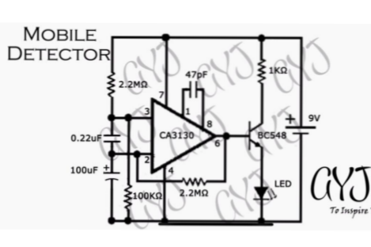
Circuit Diagram-

Slide 6
Components-
i. CA3130 IC. ix . Light Emitting Diodes
ii. 1kΩ resistor x. 9v Power Supply
iii. 100kΩ resistor xi. Wires
Iv. Two 2.2MΩ resistors. xii. General Purpose Board
v. 47pF capacitor xiii. Breadboard
vi. 0.22𝜇F capacitor xiv. Digital Multimeter
vii. 100𝜇F capacitor
viii. BC548 Transistor

Slide 7
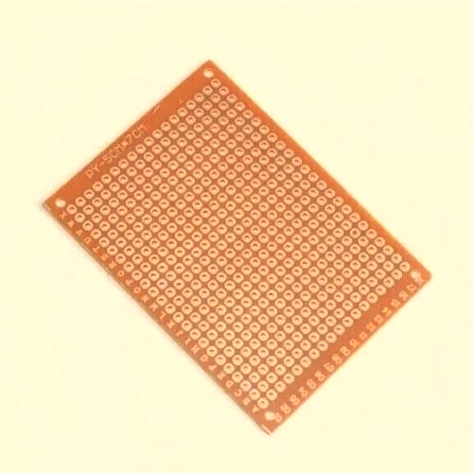
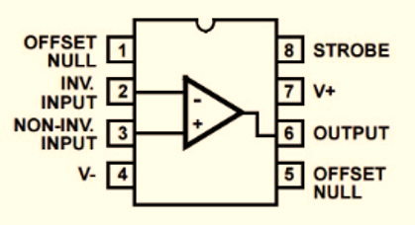
WORKING OF CIRCUIT COMPONENTS
PCB BORD :
PCB Bord is used in this circuit
CA3130 IC :
CMOS version gate-protected p-channel MOSFET.
Acts as an Differential Amplifier.
Used in the circuit as a Current to Voltage converter.
Provides very high input impedance, very low input current and very high speed of performance.

Slide 8
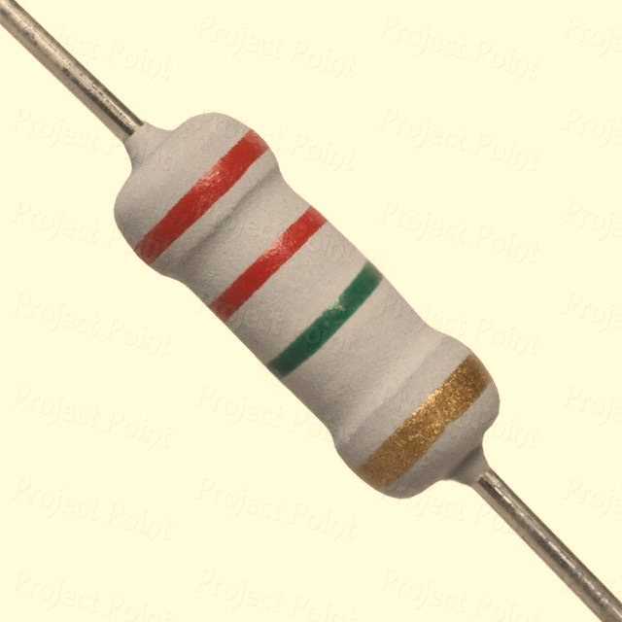
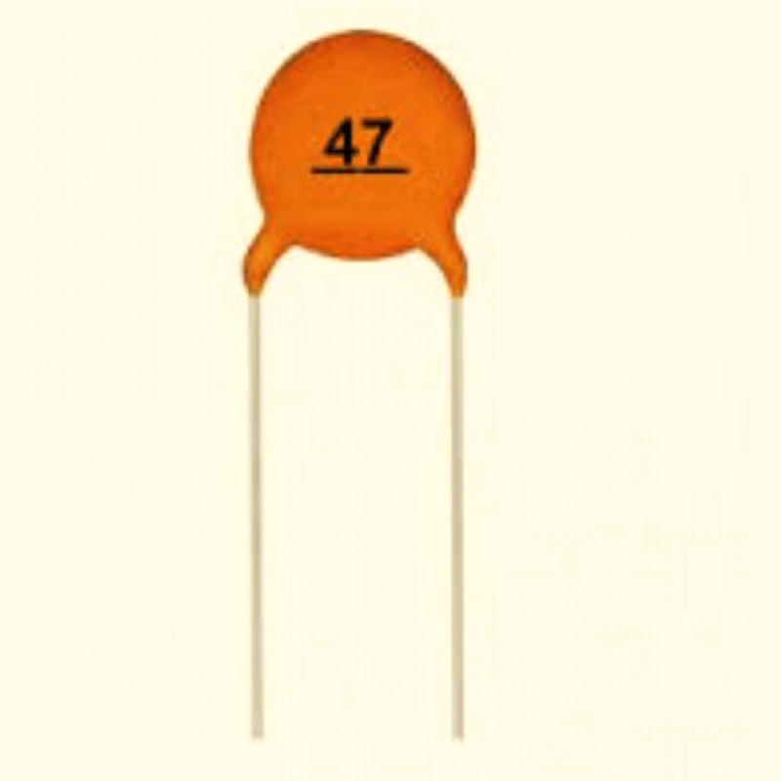
2.2MΩ RESISTIR :
Colour code : Red,Red,Green and Gold.
Makes the inverting input high when output becomes high
47pF CAPACITOR :
Ceramic Capacitor acts as the dielectric.
Connected across strobe (pin 8) and null Input (pin 1) of the IC.
For phase-composition and gain control to optimize the frequency response.

Slide 9
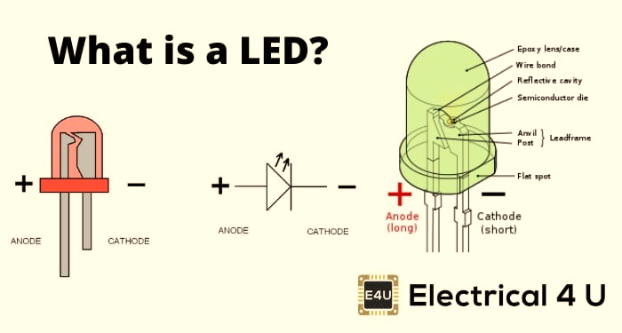
BATTERY CLIP :
Necessary for holding the battery into place.
Keep in mind the polarity, while using a battery clip.
LED:
Light Emitting Diode with two lead semiconductor light source.
It is a p-n junction diode, which emits light when activated.
We have also used connecting wires.

Slide 10
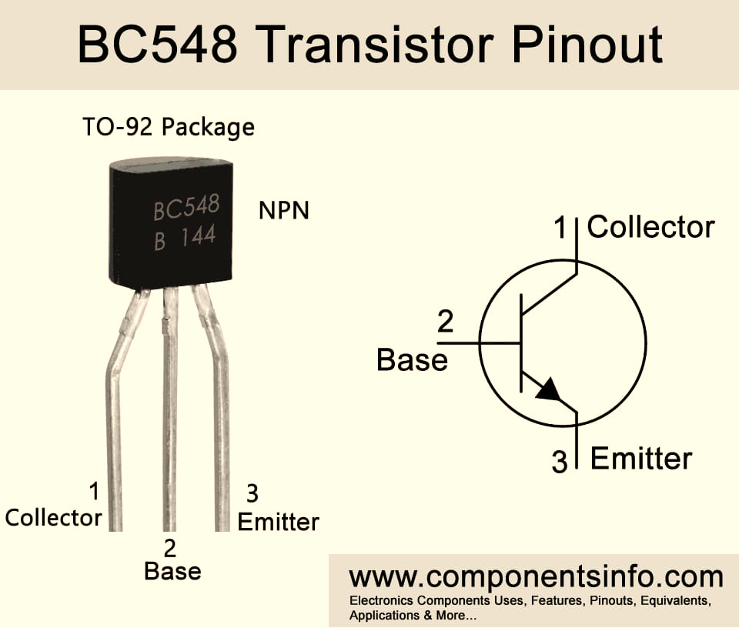
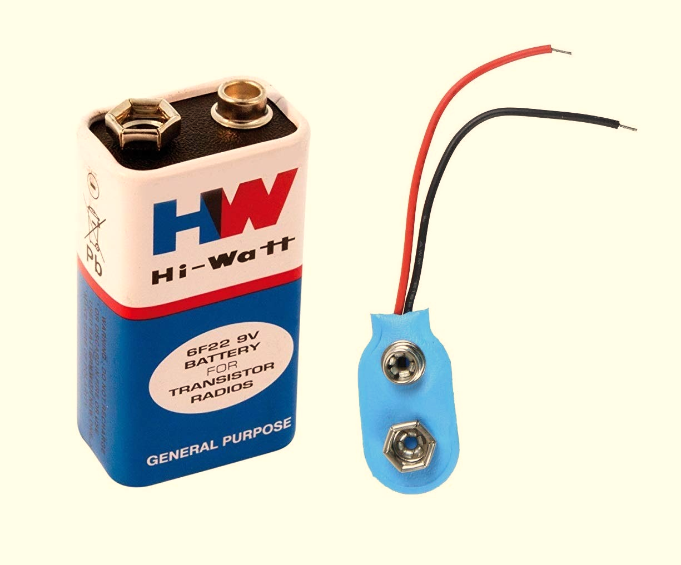
BC548 TRANSISTOR :
n-p-n type epitaxial silicon transistor.
Bindicates the material silicon and C standsfor low audio frequency.
Mainly use for switching and amplification purposes.
9 V BATTERY:
Rectangular prism shape with round edges and a polarized snap connector at the top.
This type is commonly used in walkie talkies, clocks and smoke detectors.

Slide 11
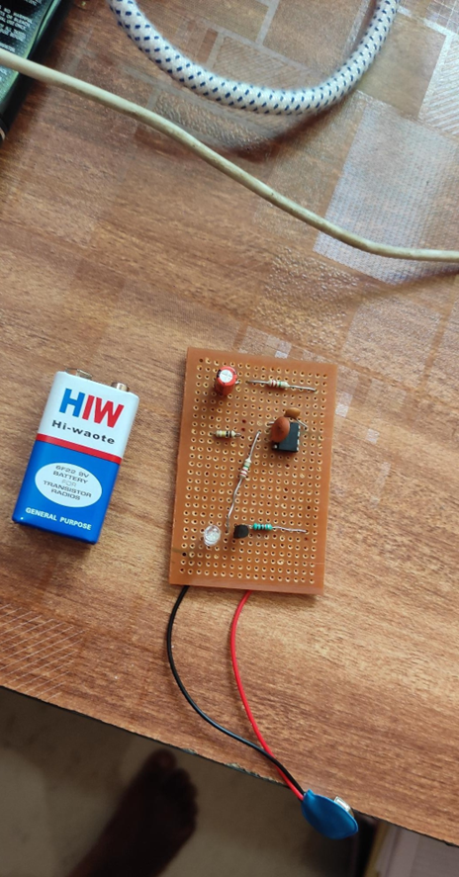
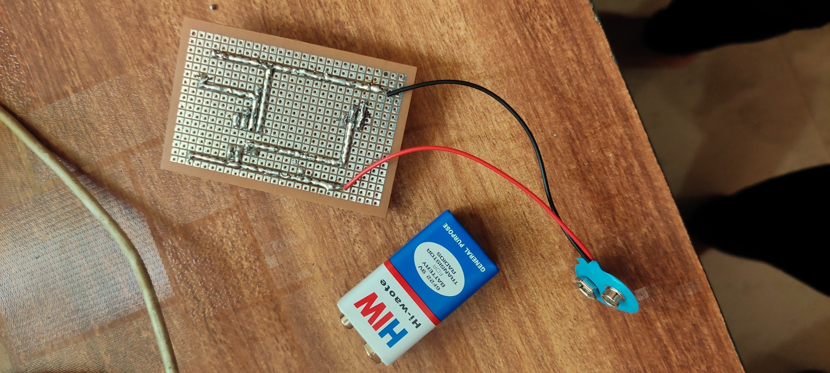
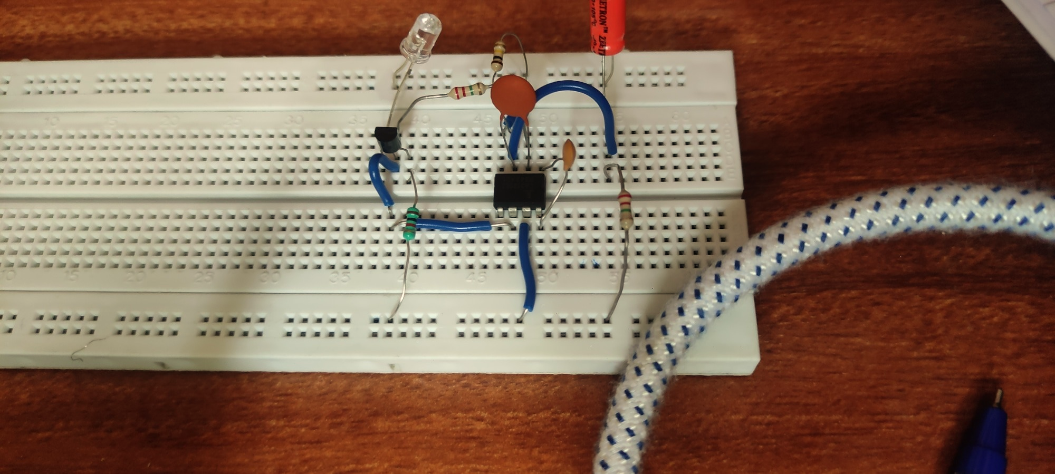
Circuit On PCB & Bread Bord

Slide 12
Basic Principle of Mobile Phone Detector Circuit:
The basic principle behind the Cell Phone Detector circuits is to detect the RF Signals. In the Schottky diode circuit, the Schottky Diode is used to detect the cell phone signal as they have a unique property of being able to rectify low frequency signals, with low noise rate. When an inductor is placed near the RF signal source, it receives the signal through mutual induction. This signal is rectified by the Schottky diode. This low power signal can be amplified and used to power any indicator like an LED in this case.

Slide 13
Working-
The Op-amp part of the circuit acts as the RF Signal Detector while Transistor part of the circuit act as the indicator. The capacitors collection along with the antenna are used to detect RF Signals when a cell phone makes (or receives) a phone call or sends (or receives) a text message.
Op-Amp reads the signals by converting the rise in current at input to voltage at output and the LED will be activated.

Slide 14
ADVANTAGES-
It can sense the presence of an activated mobile phone from a distance of one and a half meters. So it can be used to prevent use of mobile phones in examination halls, confidential rooms, etc.
Smader in size.
Detection of hidden cell phones
APPLICATIONS
It is useful where use of mobiles are prohibited
Petrol Pump
Gas Station
Historical Place
Religious Places
Examination Hall
Military Bases
Hospitals

Slide 15
Future Application of Cell Phone Detector
Trying to increase the detecting range of mobile bug to few more meters for observing wide ranges of area. In the future time this detector will be improved in all ways.
In future we could be able to detect any range of frequency over a meters of range and this will be very useful to detect the cell phones where the cell phones are prohibited.

Slide 16
Conclusion of Cell Phone Detector
Cellphone detector is a po”erful tool, easy to deploy and cost eective device thatconstantly scans for cell phone activity and can immediately alert security sta to the presence of an intruder
This pocket-size mobile transmission detector or sniffer can sense the presence of an activated mobile cellphone from a distance of one and-a-half meters. So it can be used to prevent use of mobile phones in examination halls, confidential rooms, etc. It is also useful for detecting the use of mobile phone for spying and unauthorized video transmission.
In this project we made an attempt to design a mobile detector which can detect both the incoming and outgoing calls as well as video transmission even if the mobile is kept at the silent mode. Our circuit has detected the presence of an active mobile phone even at a distance of about one and half a meter. It gave the indication of an active mobile phone by glowing the LED

Slide 17
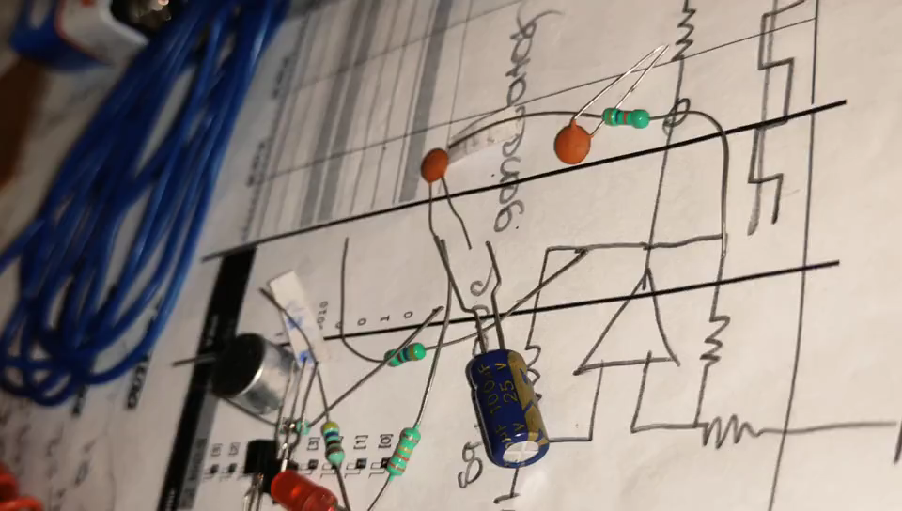
Circuit Video :

Slide 18
THANK YOU ALL

